Slide 1
House price prediction Analysis
Balakrishnan S
19-08-2017

Slide 2
Business Problem
A dataset has been provided to predict the Sale price of Houses during the year 2010.
Data is split across Train and Test
Number of Features : Train – 80, Test – 79 (without dependent variable)
Number of observations: Train - 1460, Test – 1459
Dependent variable : Sale price

Slide 3

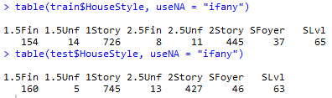
Data Preparation
Three types of missing data in this problem – Missing data (NA) , Incorrect data & Level mismatch. Data is missing for 34 features. Approximately 24% of total data.
Incorrect Data - Missing values also contains actual values incorrectly tagged as NA.
For example, Fence categorical feature contains NA values. And in the data description ‘No fence’ is denoted as NA. This does not mean that the data is missing , hence the level can be modified/renamed from NA to ‘None’ or ‘NoFence’.
Level mismatch – 11 Character variables between Train and Test data has mismatch in levels.
For example, HouseStyle has 8 levels in Train whereas only 7 levels in Test data. This mismatch will lead to contrast error when we predict from the model. Hence we must generalize levels between Train & Test.

Slide 4

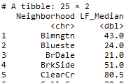
Missing data –
BsmtFinSF1, BsmtFinSF2, BsmtUnfSF, TotalBsmtSF, BsmtFullBath, BsmtHalfBath, BsmtHalfBath – All these features contains NA because those observations does not have Basement. Hence replace zero for missing values.
For Functional, MSZoning & KitchenQual, SaleType – Compute the mode & assign it in place of missing values.
For MasVnrArea & MasVnrType, we have 23 NAs out which all MasVnrArea ‘s NA equals MasVnrType NAs except one (row# 2611) missing value. All the other NAs are not missing but has no data.
Hence impute missing value by mean average and change the other MasVnrType to “None” and MasVnrArea to zero.
LotFrontage – LotFrontage and Neighbourhood seems to be correlated, Hence we take a table wise average of LotFrontage by Neighbourhood.
With this average & using Ave function, we fill in the missing
values for LotFrontage.

Slide 5
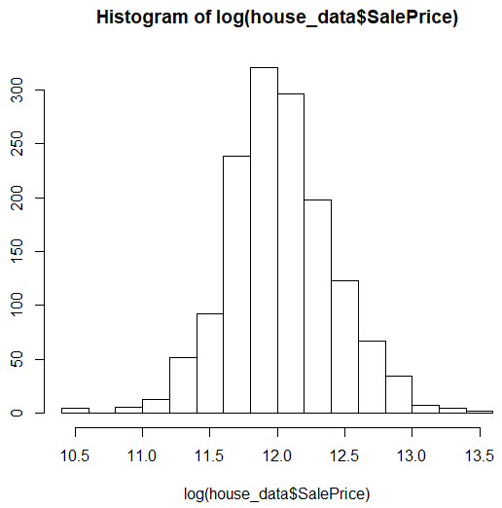
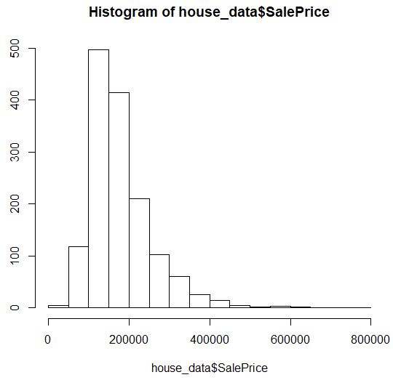
Exploratory Data Analysis
We found that the dependent variable is Negatively Skewed.
Hence we performed a Log transformation after which the SalePrice was normally distributed. The same log transformation must be done for all other numeric variables.

Slide 6
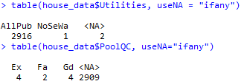
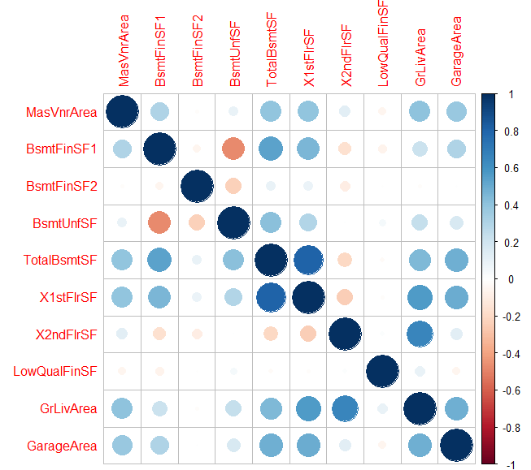
Utilities and PoolQC does not have their levels equally spread. Utilities has 99% AllPub and the remaining as NoSeWa. This feature also leads to the contrast error .
For PoolQC, except 10 , all are NAs. So we are removing both these
features from the model.
→
Out of the whole correlation matrix these Area features show high correlation between each other.
With this correlation, we will perform Feature Engineering.

Slide 7
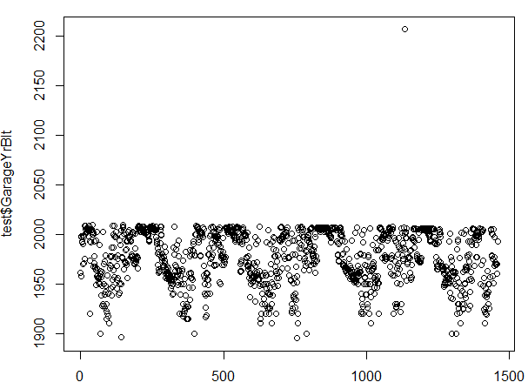

Outlier Detection
Outliers are not given much importance here as the data size is small compared to features. And most of the outliers falls in Test data. And we are expected to predict with the actual Test data.
We came across a feature GarageYrBlt. This Feature has max value of 2207 in Test data. The year the dataset was created is at 2010 hence this is an outlier.
Hence we assumed 2207 should be 2007 and updated the same
In the dataset.

Slide 8
Significance of data
Linear Regression
Without any Feature Engineering, we performed a Linear Regression on the model with this data.
As this dataset is highly correlated between each of the independent variables, Linear Regression will not yield better result.
With this linear model we can understand the most significant features and the change in ‘Adjusted R^2’ value when we add or remove features.
Principal Component Analysis
As we have more features, and we can see high correlation between these features, PCA can be used.
First we will perform PCA and then Factor Analysis to see how the data can be differentiated.

Slide 9
We have ~40 numeric features. Out of 40 components, we see around 13 components that has Eigen value > 1 and high variance. Hence we select these 13 components aiming to not miss any critical data.
The categorical variables from the dataset are extracted and combined with these 13 PCs and created as a data frame.
With this dataset we performed a linear regression. With this regression, we can see better significance than the regression on actual data.
Although we see a difference, the graph between Actual and predicted data is more or less same between normal and PCA regression.
We keep the PCA results saved and proceed with Factor Analysis.
FA has been performed and the final analysis is here

Slide 10
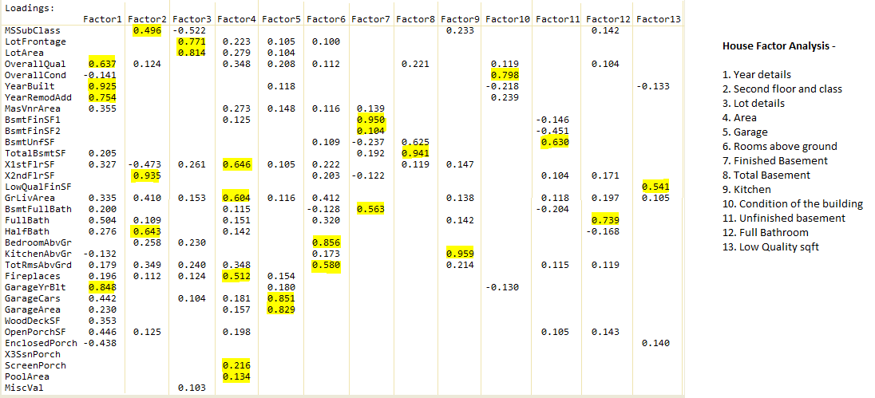
Factor Analysis

Slide 11


Feature Engineering
Started with the Year data – YearBuilt, GarageYearBuilt & RenovatedYear. Found number of years from the actual year and did a binning on those years.
Added most of the square feet data and created a new feature out of it.
Reduced levels of many categorical features that has more levels. Example, HouseStyle contains two or three levels with 1 story and 2 story. Hence we combined all the 1 story as a feature and 2story as another feature, etc.
Performed one hot encoding on many of the categorical features.
For Features with only two possible levels as ‘0’ or ‘1’, one hot encoding is not needed. For example, a feature to check if we have a Garage or not (1 or 0). Then the same feature would contain either 1 if Garage is present and 0 if not. So one-hot encoding of creating two features out of this is not required.

Slide 12
Other Techniques
Other than LM and PCA, we used Random Forest , Elastic net regression and XGBoost on the data.
Random Forest does not need any interaction or binning as it would automatically apply those as part of the model building.
Elastic-net regression did a decent job but again we received the same result as that of the linear regression performed before. The binning did not help much here.
Finally, XGBoost model gave the best result as it will perform well with one hot encoding data.
We calculated RMSE with all of the models and the XGBoost is the one that gave the best result, whereas the relationship between the Actual and Predicted data was better shown in Random Forest only.

Slide 13
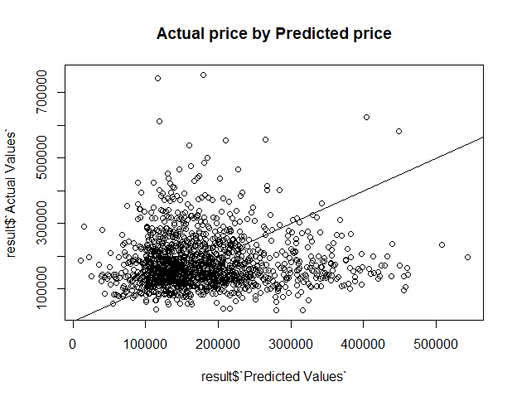
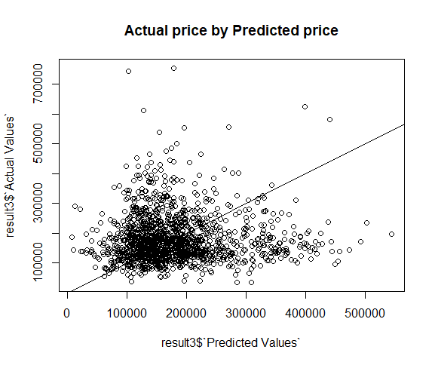
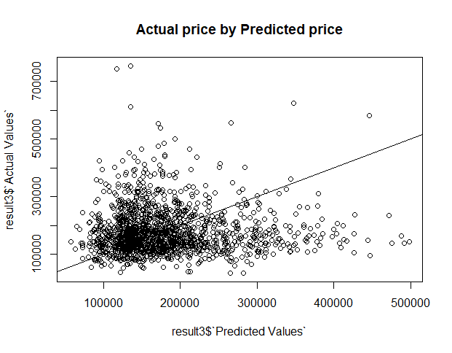
Regression Graphs
Linear Regression Elastic net regression
PCA on Linear Regression

Slide 14
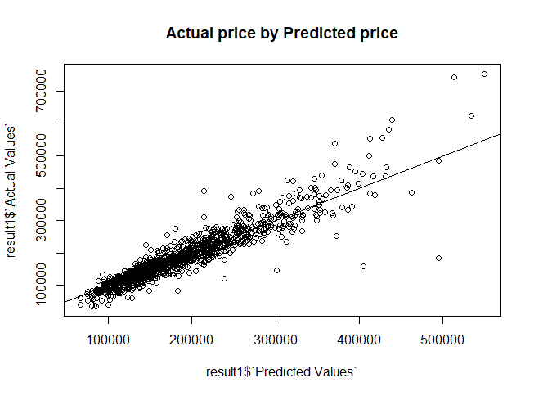
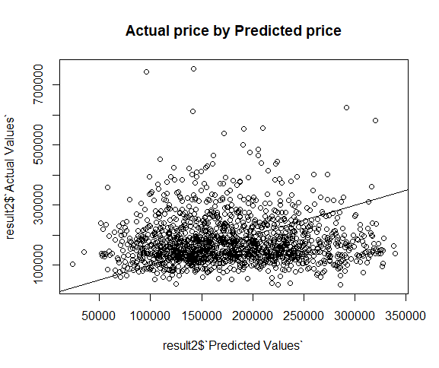
Random Forest
XGBoost

Slide 15
Summary & Conclusion
Test data is more skewed than Train data and has more missing values. Hence every particular information in Train data is valuable and we must not remove any outliers.
House prices increase with Year.
Quality & Condition plays an important role in this model.
Performing FA helps us to understand how the features are divided and it will also help in framing interactions.
If we are using interactions then we must be careful to not over fit the model
Linear regression is not very effective if there exists multi-colinearity.
Binning will help to improve the model accuracy If there are more number of categorical features.
Best model is XGBoost for this dataset with an RMSE of 0.13142

